Slide 1
그림으로 보는 Deep Neural Network 근 현대사
불필요한 노동에서 해방되고자, 다양한 자료를 인용했습니다. 원작자님들에게 감사의 말을 드립니다.
Name: 이충기 (Chungki Lee)
Email: cklee.brain@gmail.com; chungki.lee@samsung.com
https://github.com/chungbrain

Slide 2
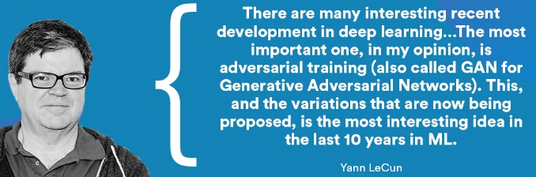
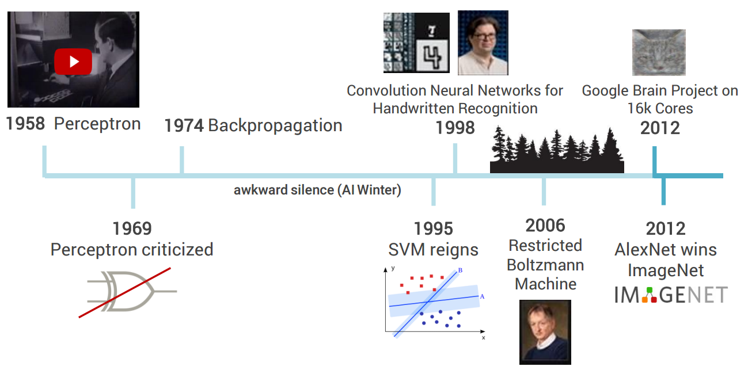
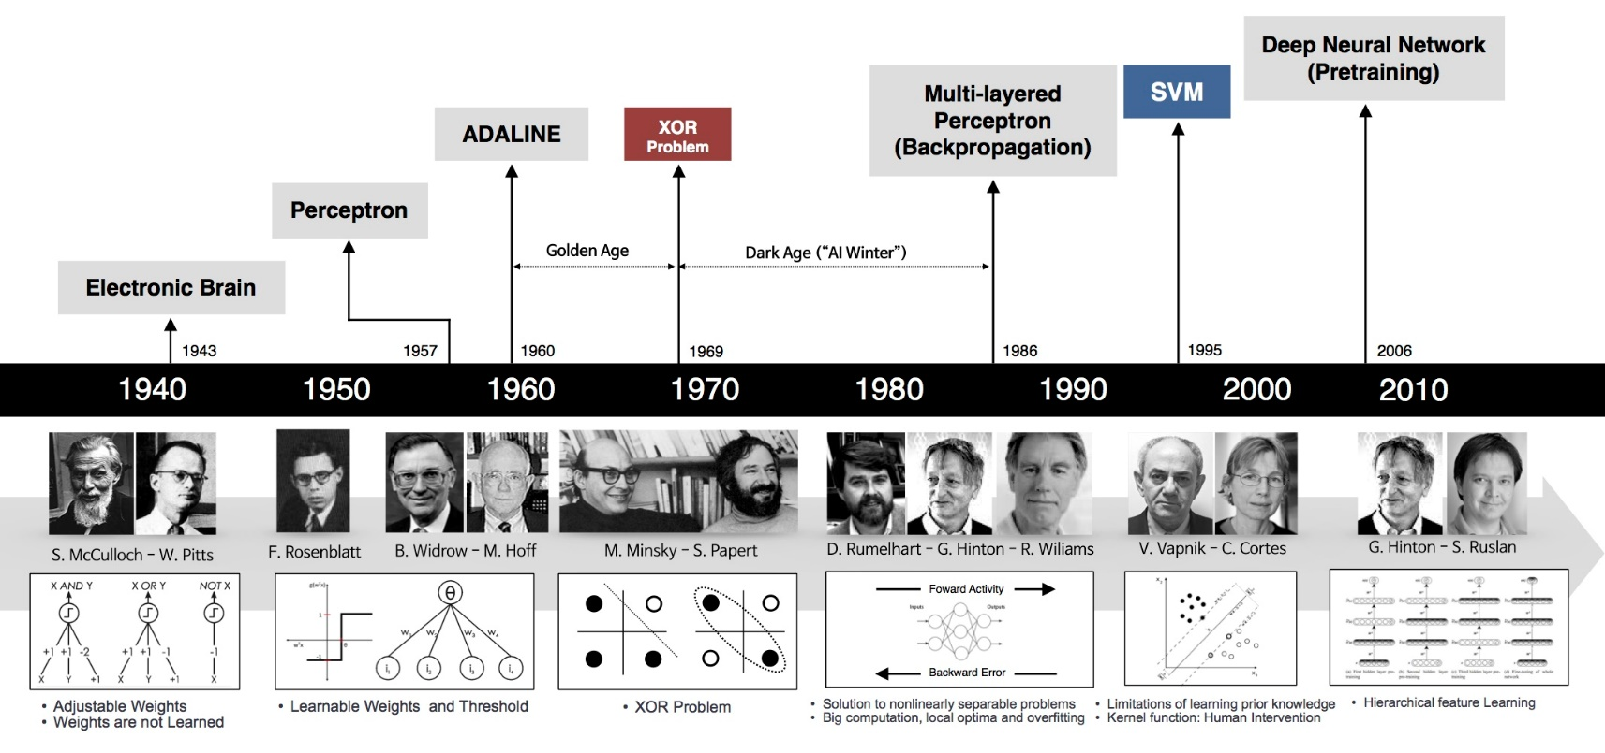
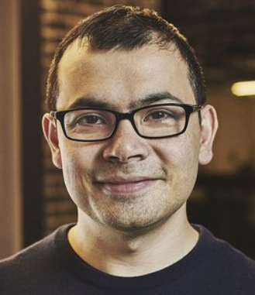
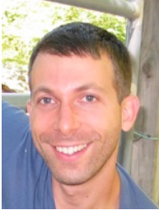

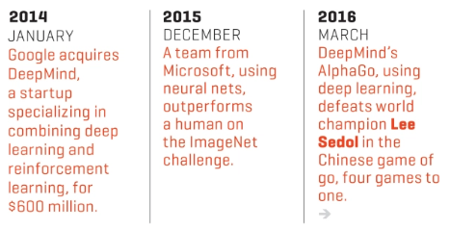
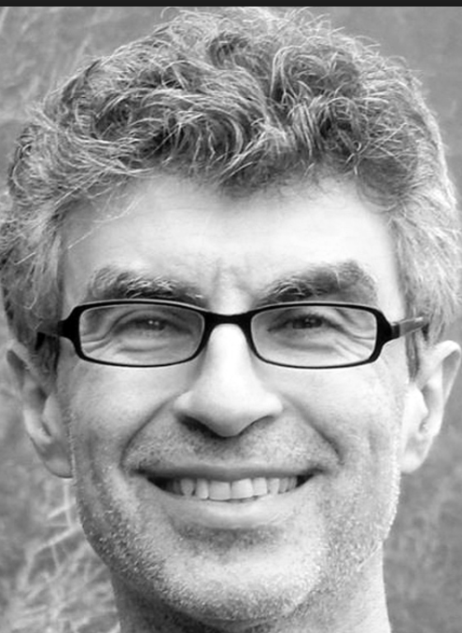
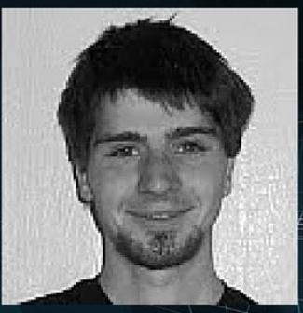
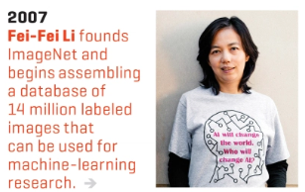
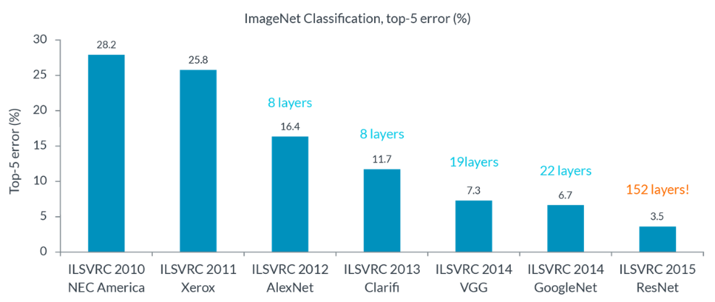
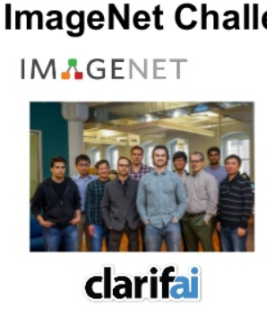
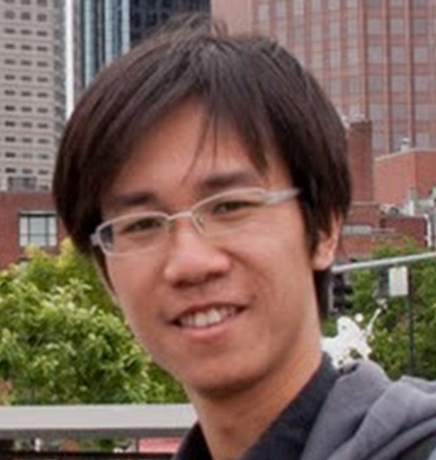
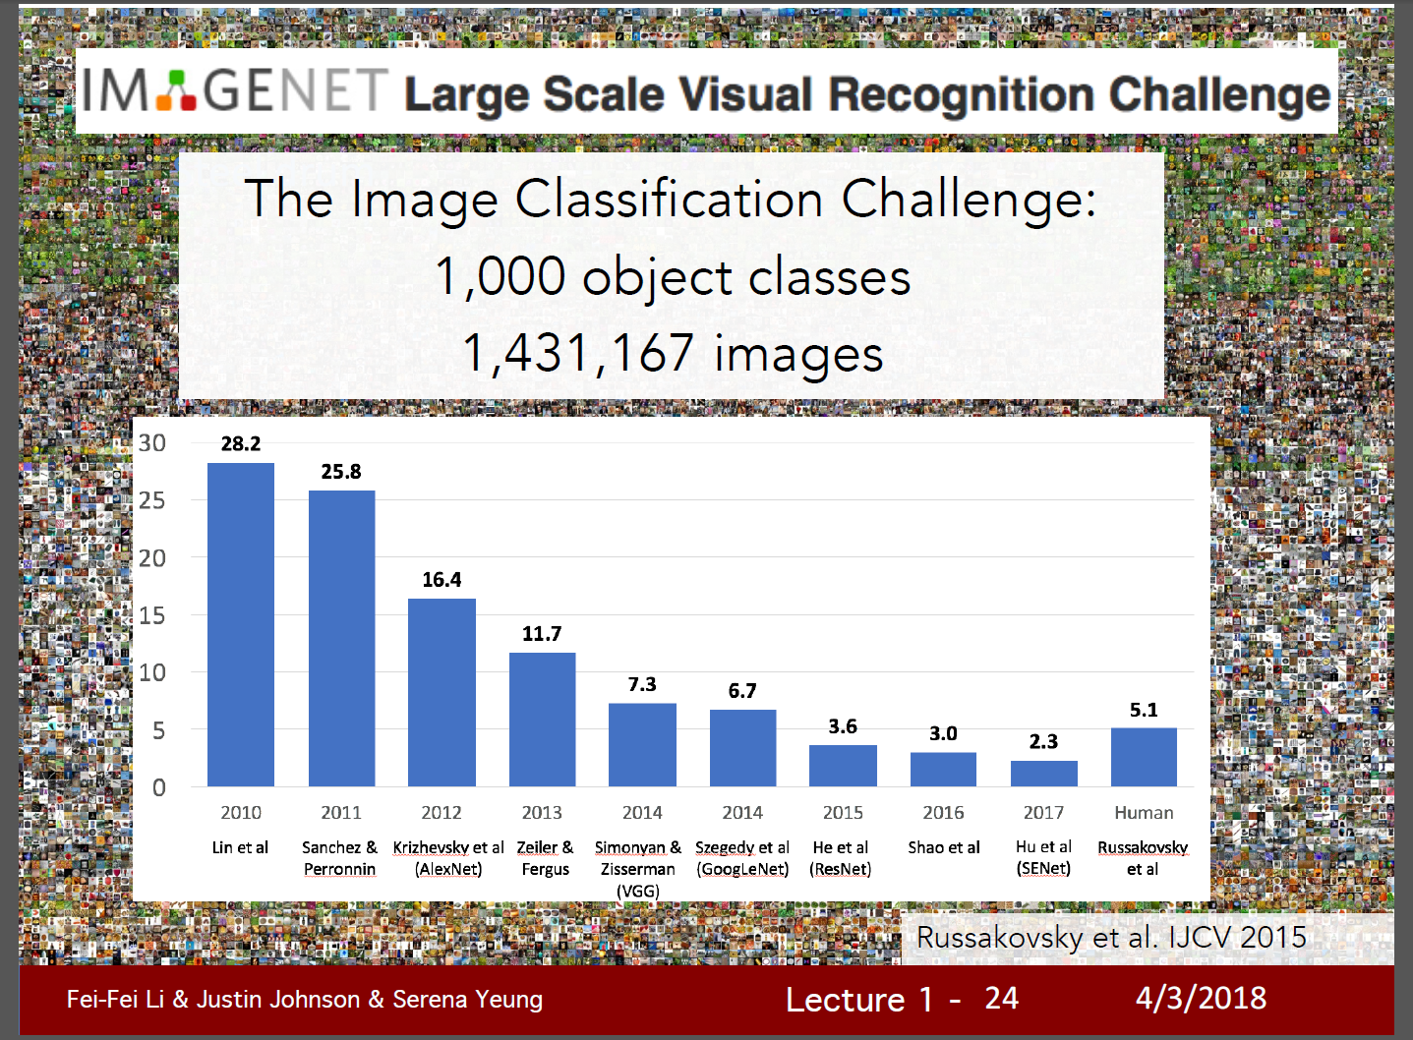
역사의 흐름 & 인물들
Y.Bengio
GAN: Ian Goodfellow
[2017 winner is ?]
http://image-net.org/challenges/LSVRC/2017/results
2015년부터 video object detection 추가됨

Slide 3
Neural Network (NN) 의 핵심 기술들
Back propagation : 너무 기초라서 패스
CNN | Semantic seg | RNN (LSTM) | Reinforcement L.. | GAN
Batch Normalization
Dropout (DropConnection)
Data augmentation
Weight initialization
Pooling
Activation Func.
업뎃예정
* 위 항목들은 뒤 슬라이드에 모두 다룰것이다.

Slide 4
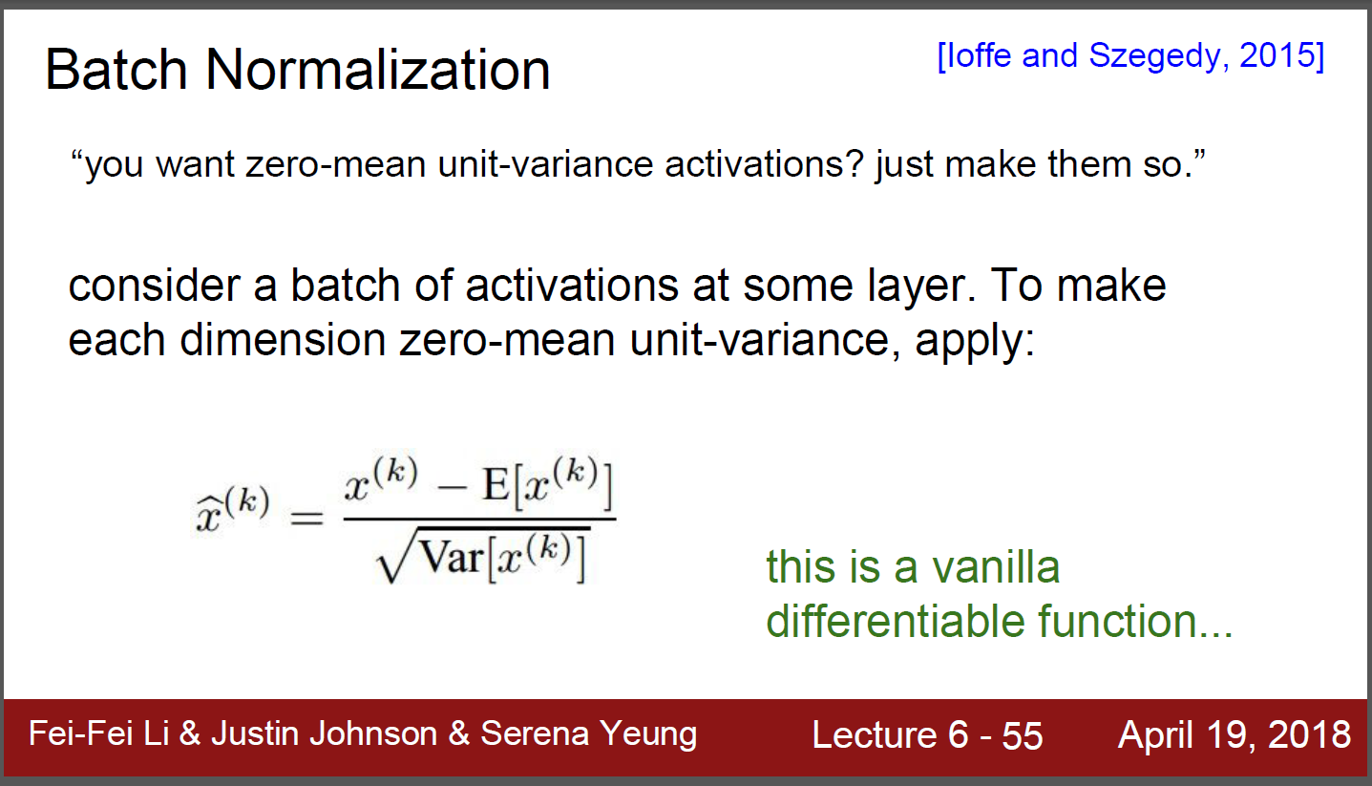
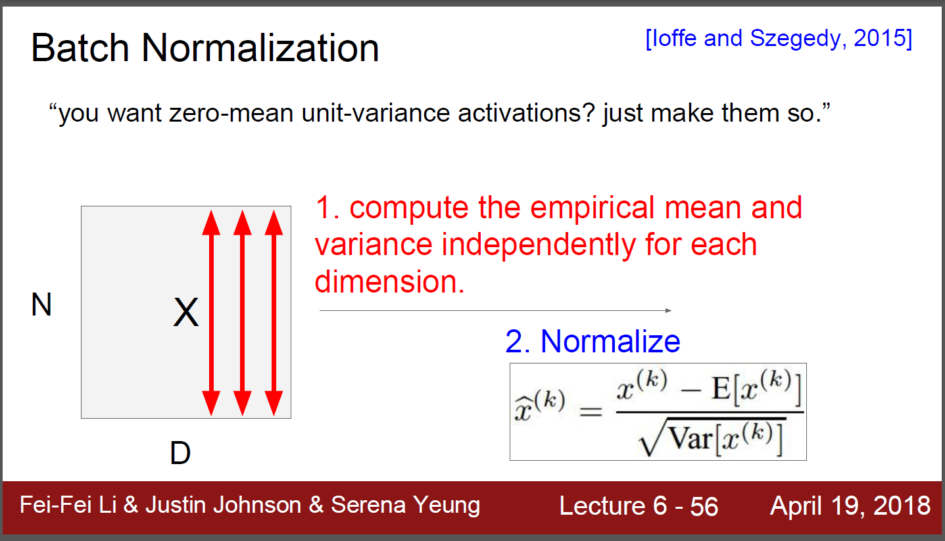
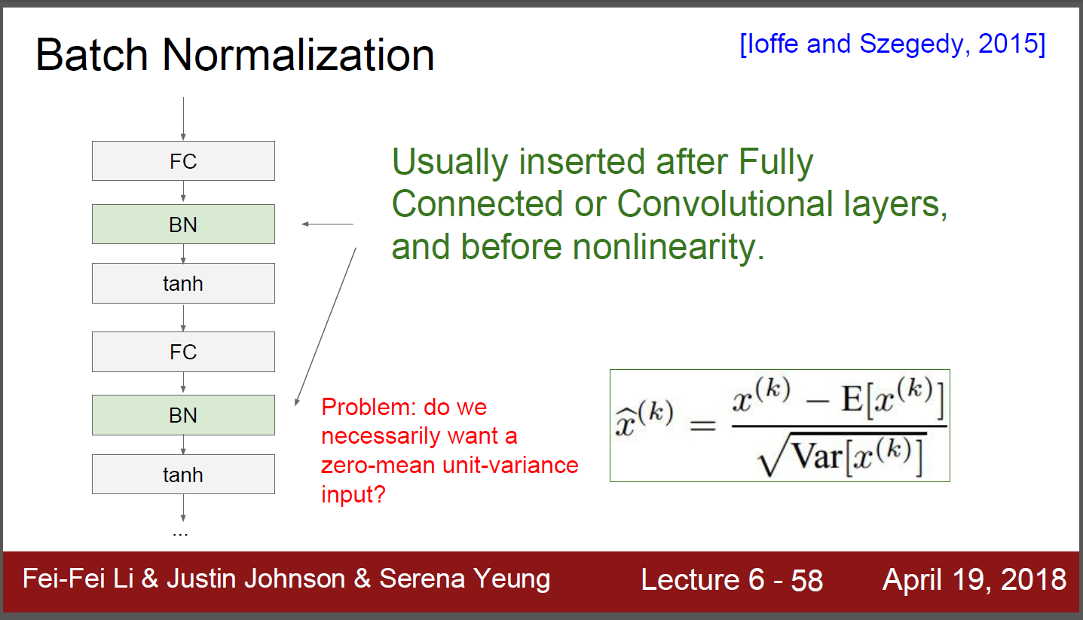
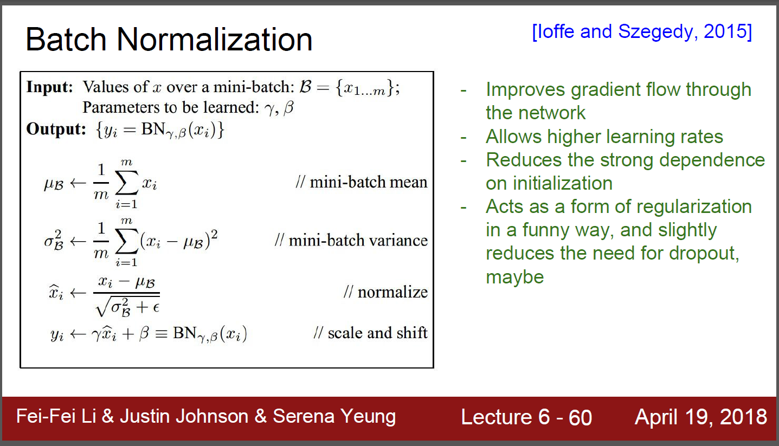
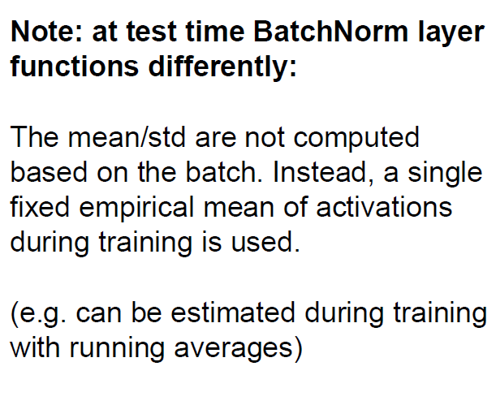
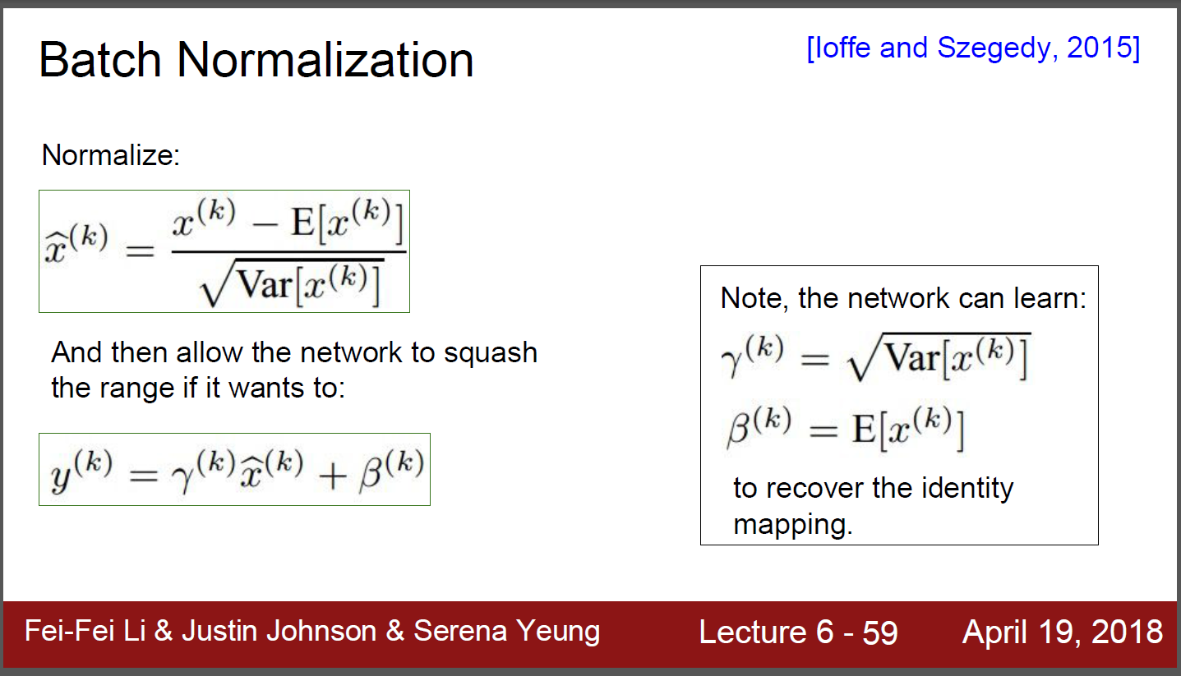
Batch normalization

Slide 5
Weight initialization
업뎃예정

Slide 6
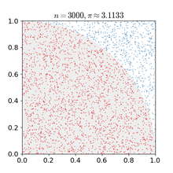
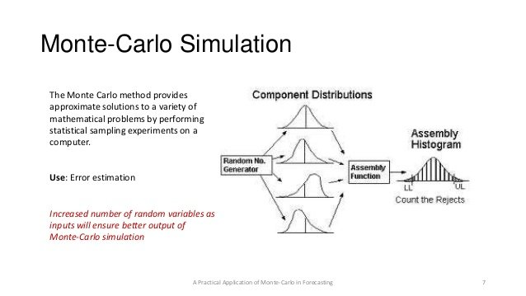
이해를 돕기 위한 기타 정보들
Monte Carlo method
1x1 convolution
Cross entropy cost function
Softmax
Bagging/adaboost
Semantic segmentation
Conditional random field (CRF)
Markov chain monte carlo (MCMC)
Convolution arithmetic (https://github.com/vdumoulin/conv_arithmetic)
Stochstic Gradient Decent (SGD)

Slide 7
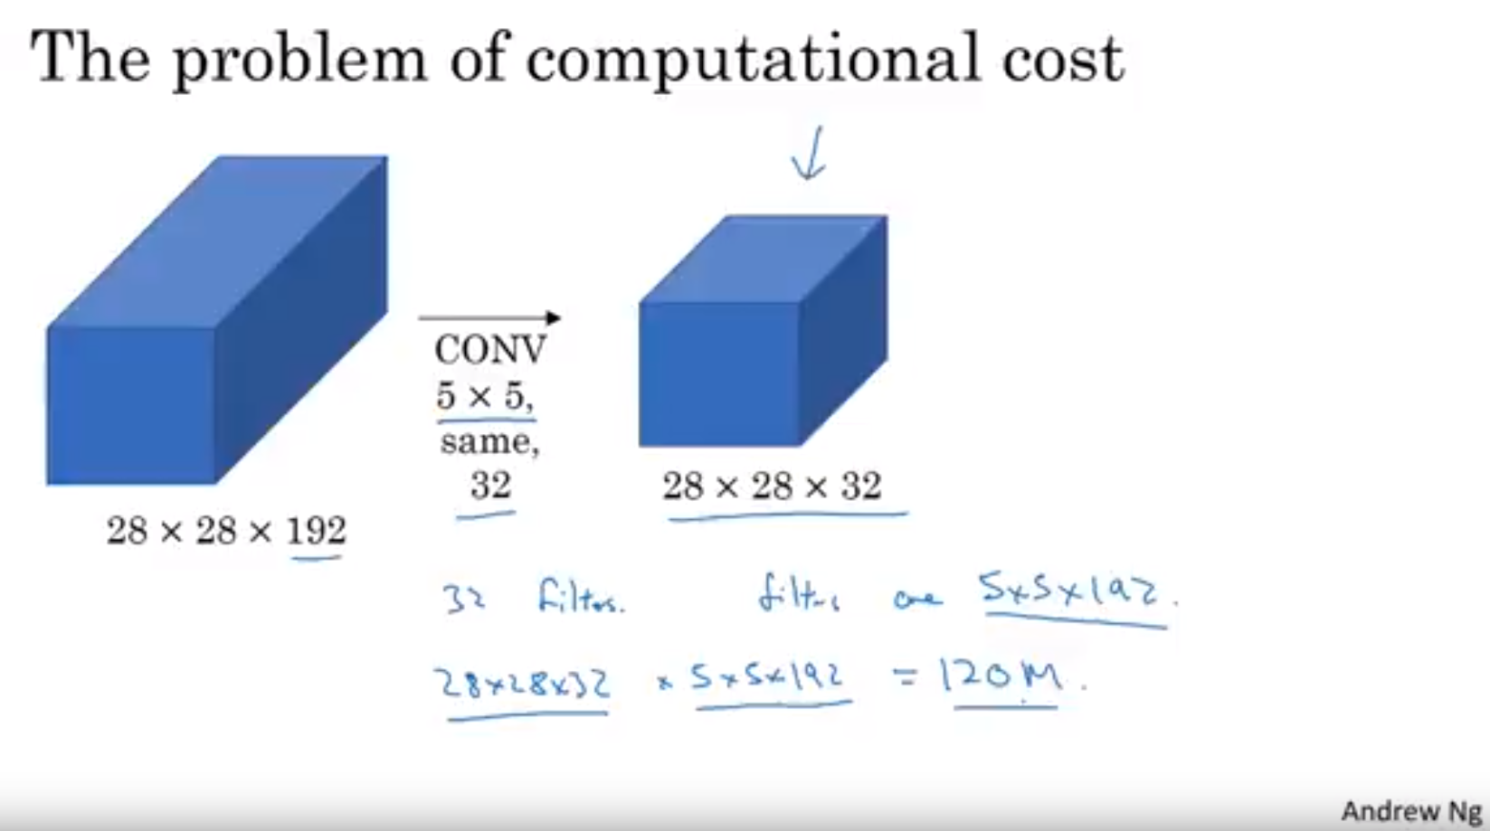
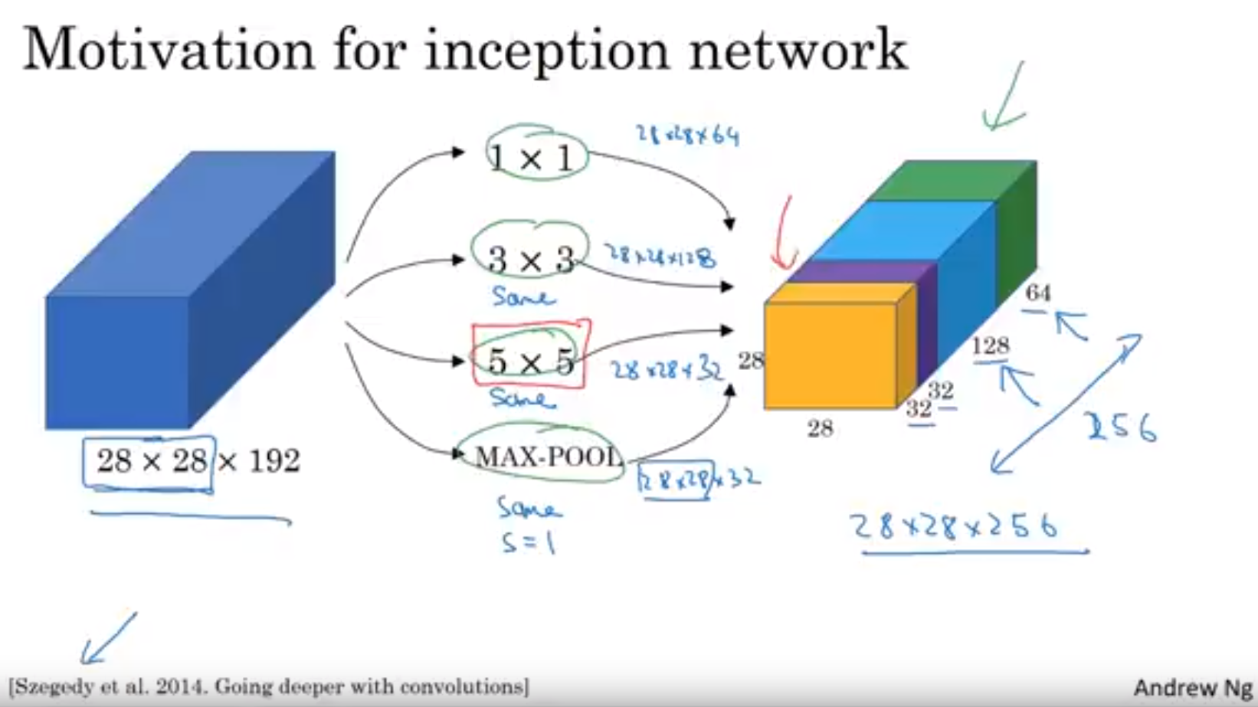
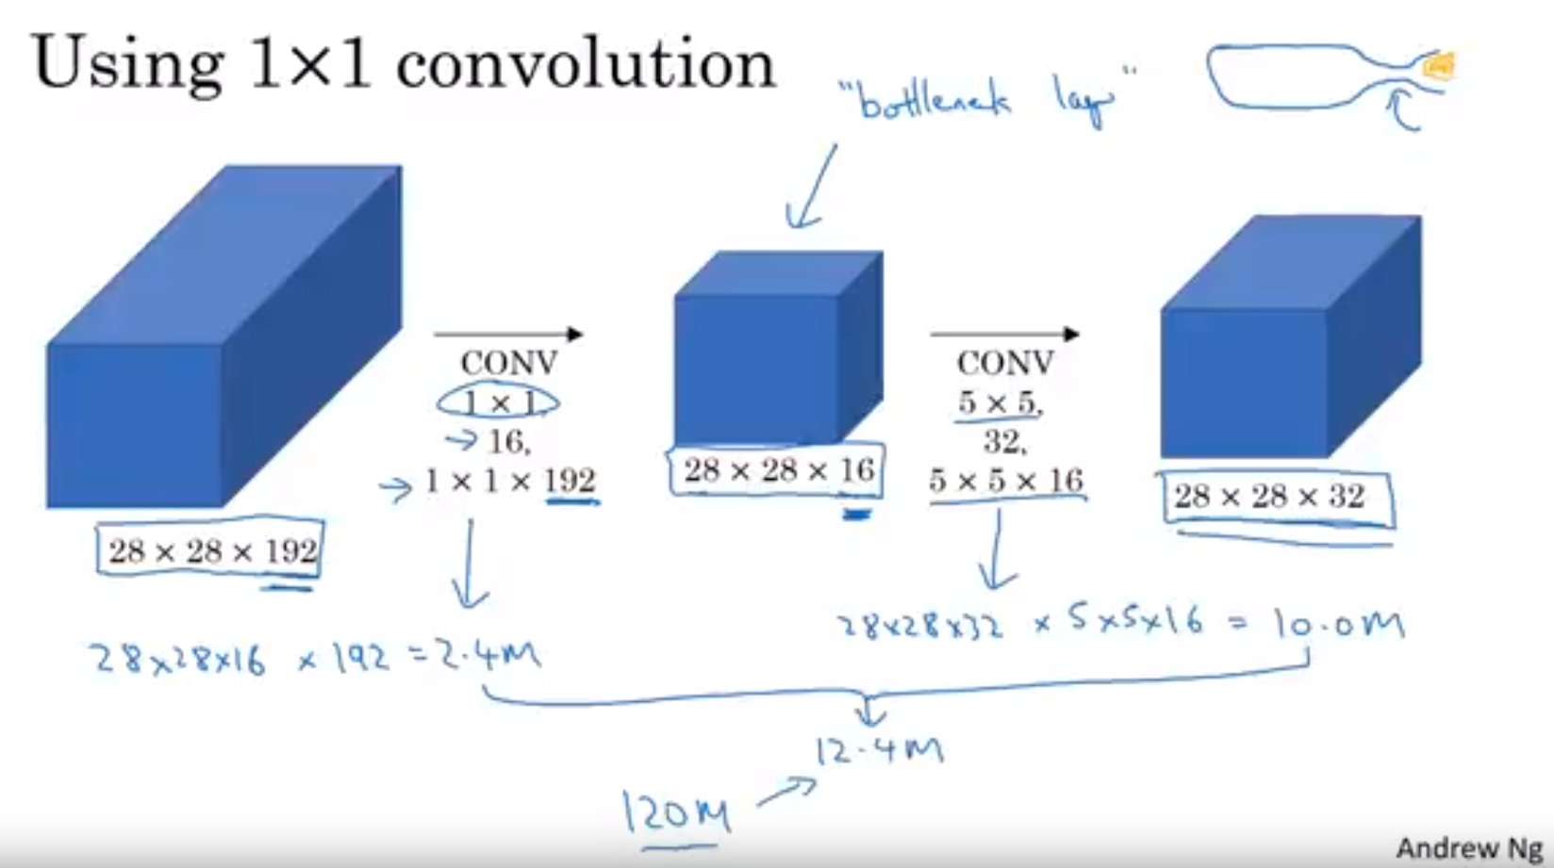
1x1 Convolution

Slide 8
Cross entropy cost function
업뎃예정

Slide 9
Softmax
업뎃예정

Slide 10
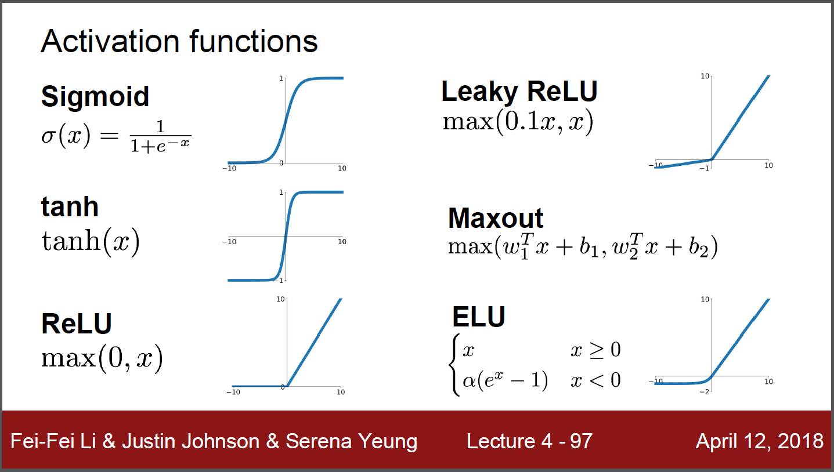
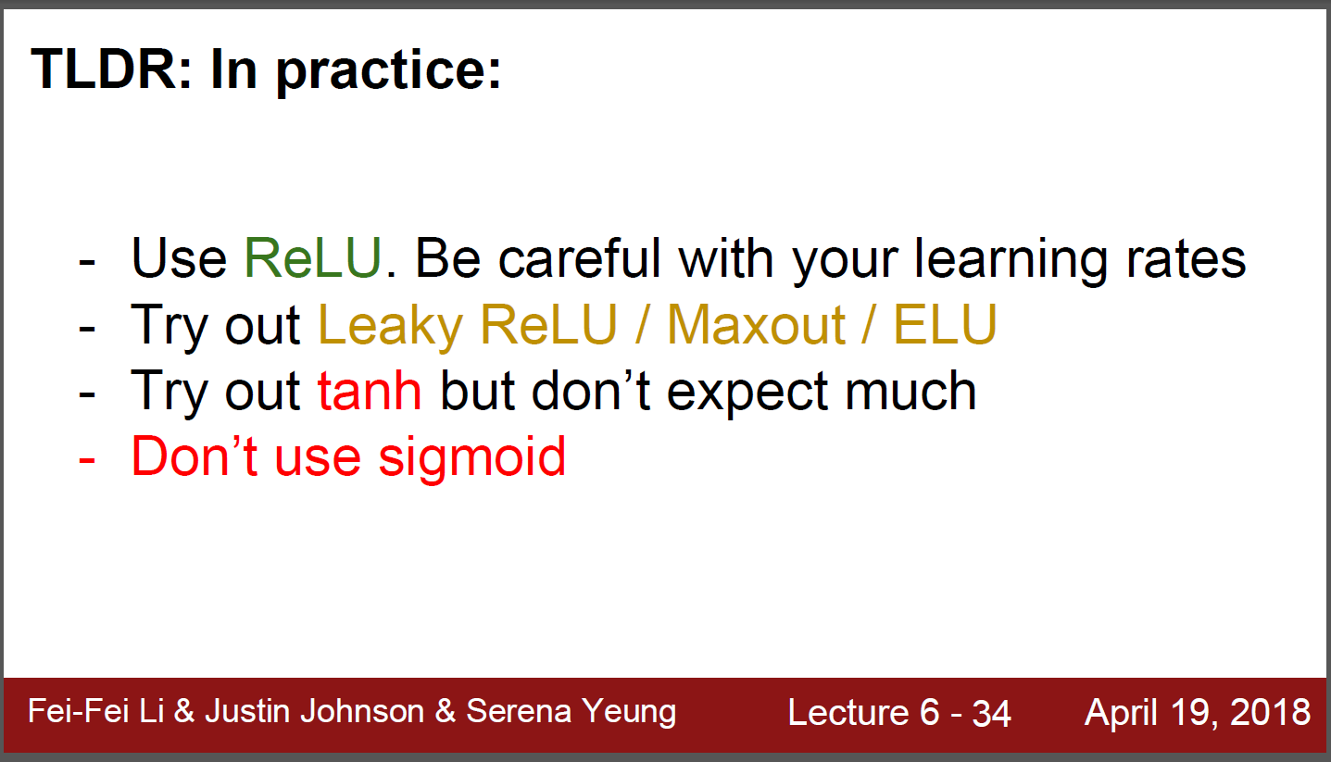
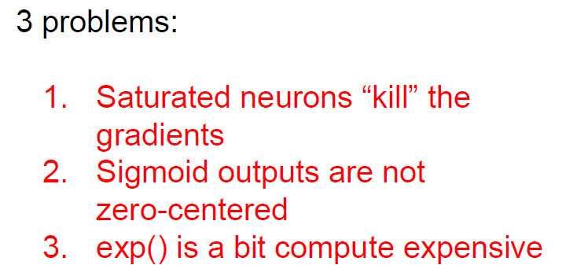
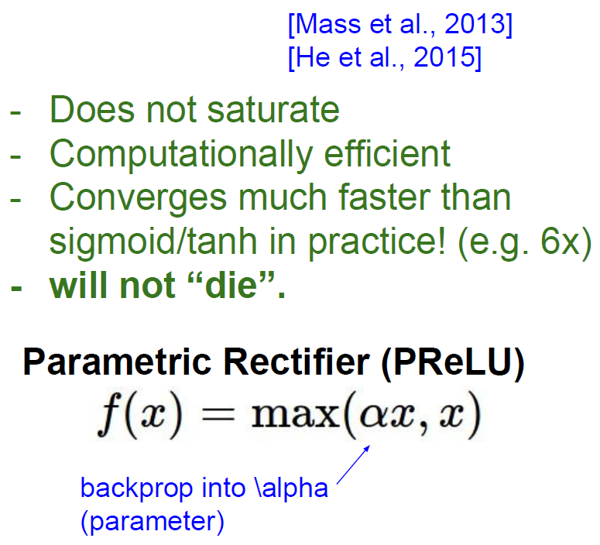
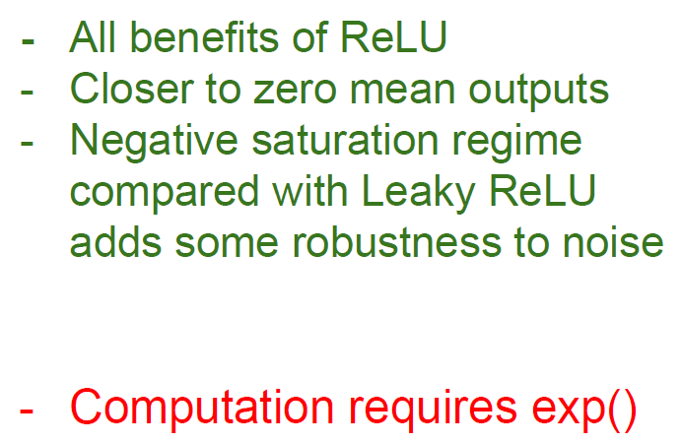
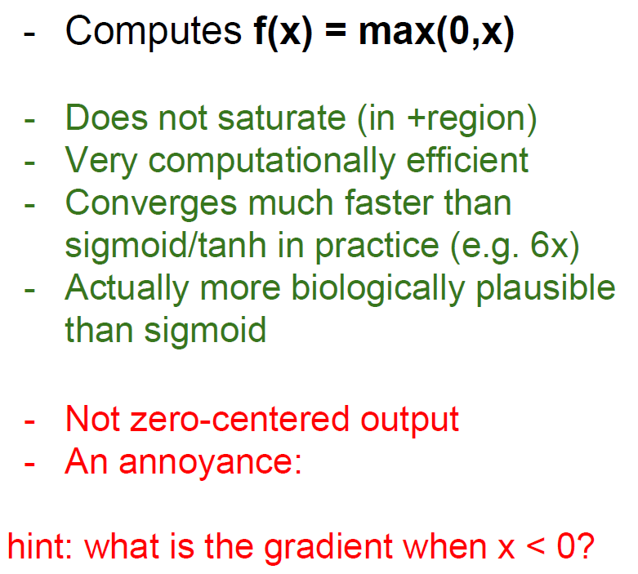
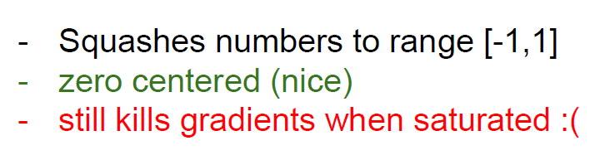
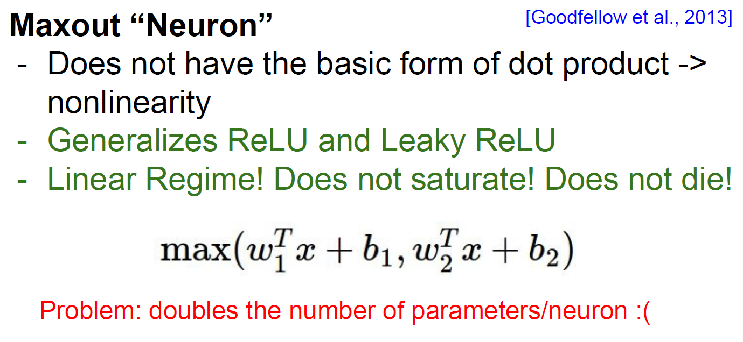
K
ReLU
Leaky ReLU
ELU
of sigmoid
Pros and cons in tanh

Slide 11
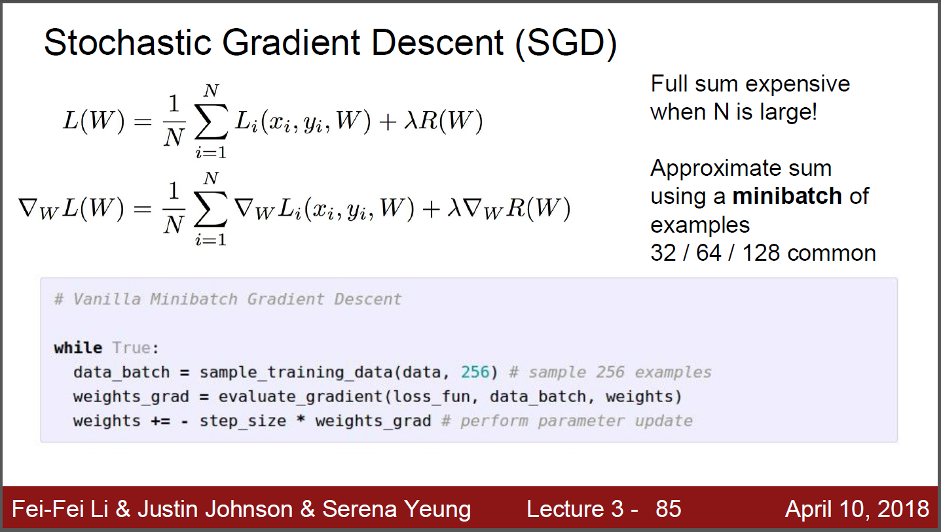
SGD

Slide 12
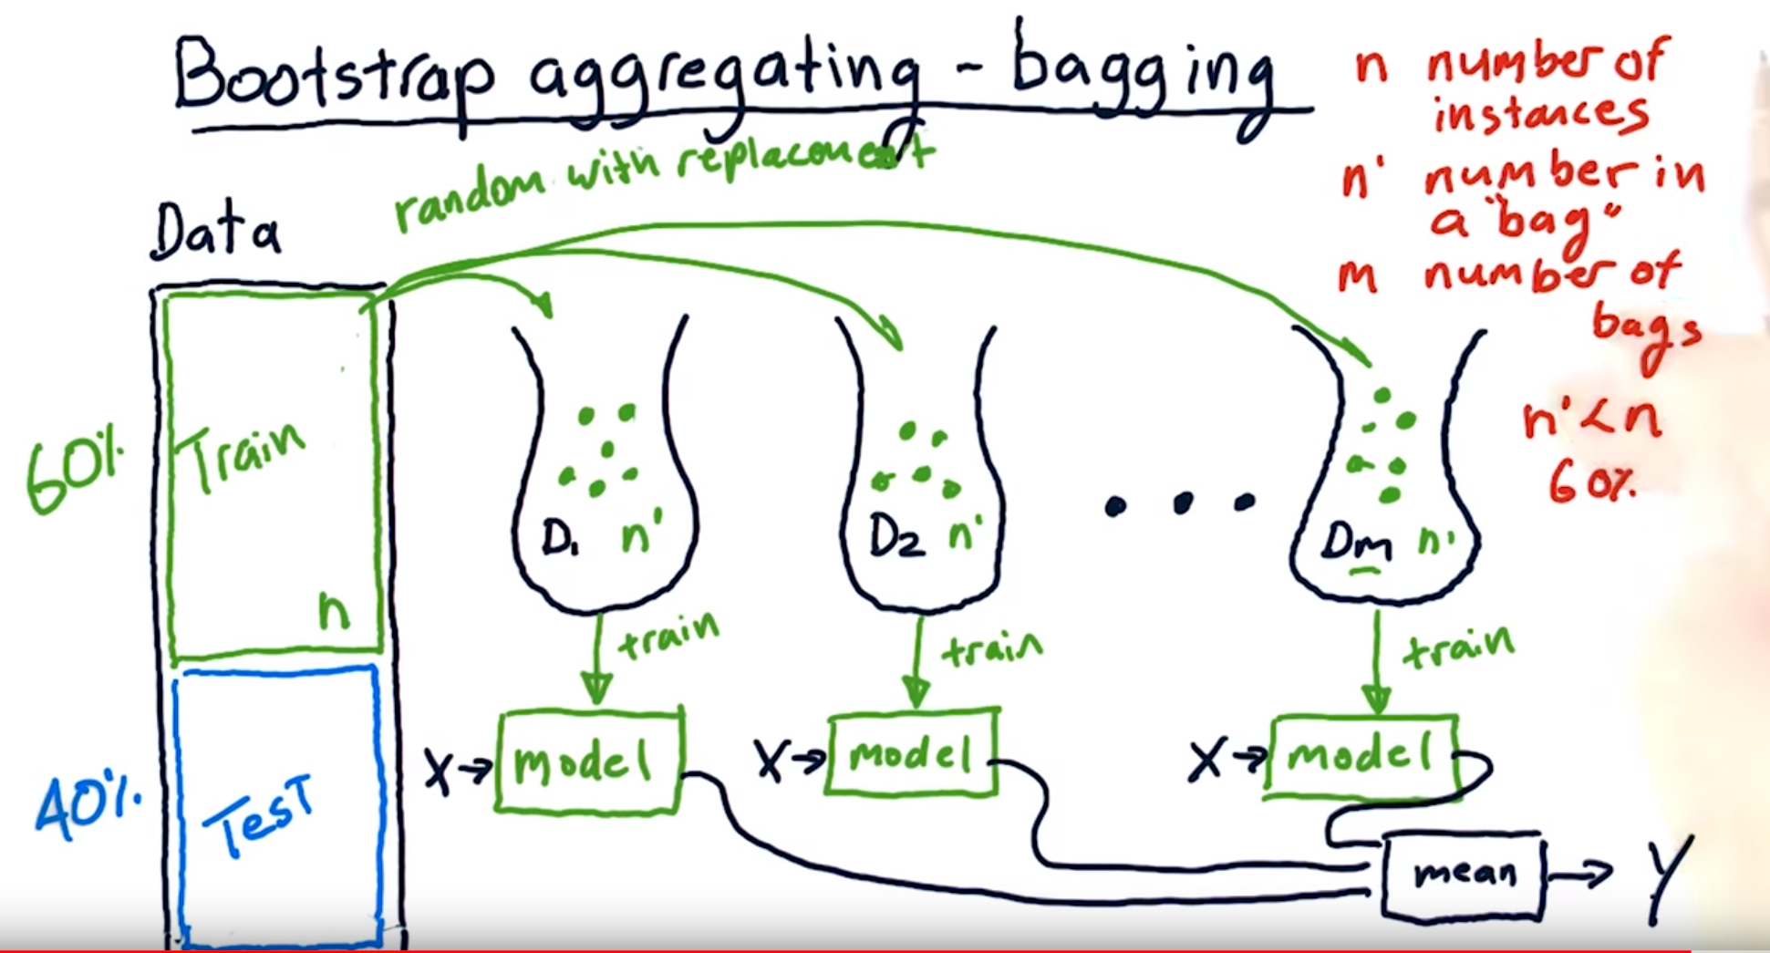
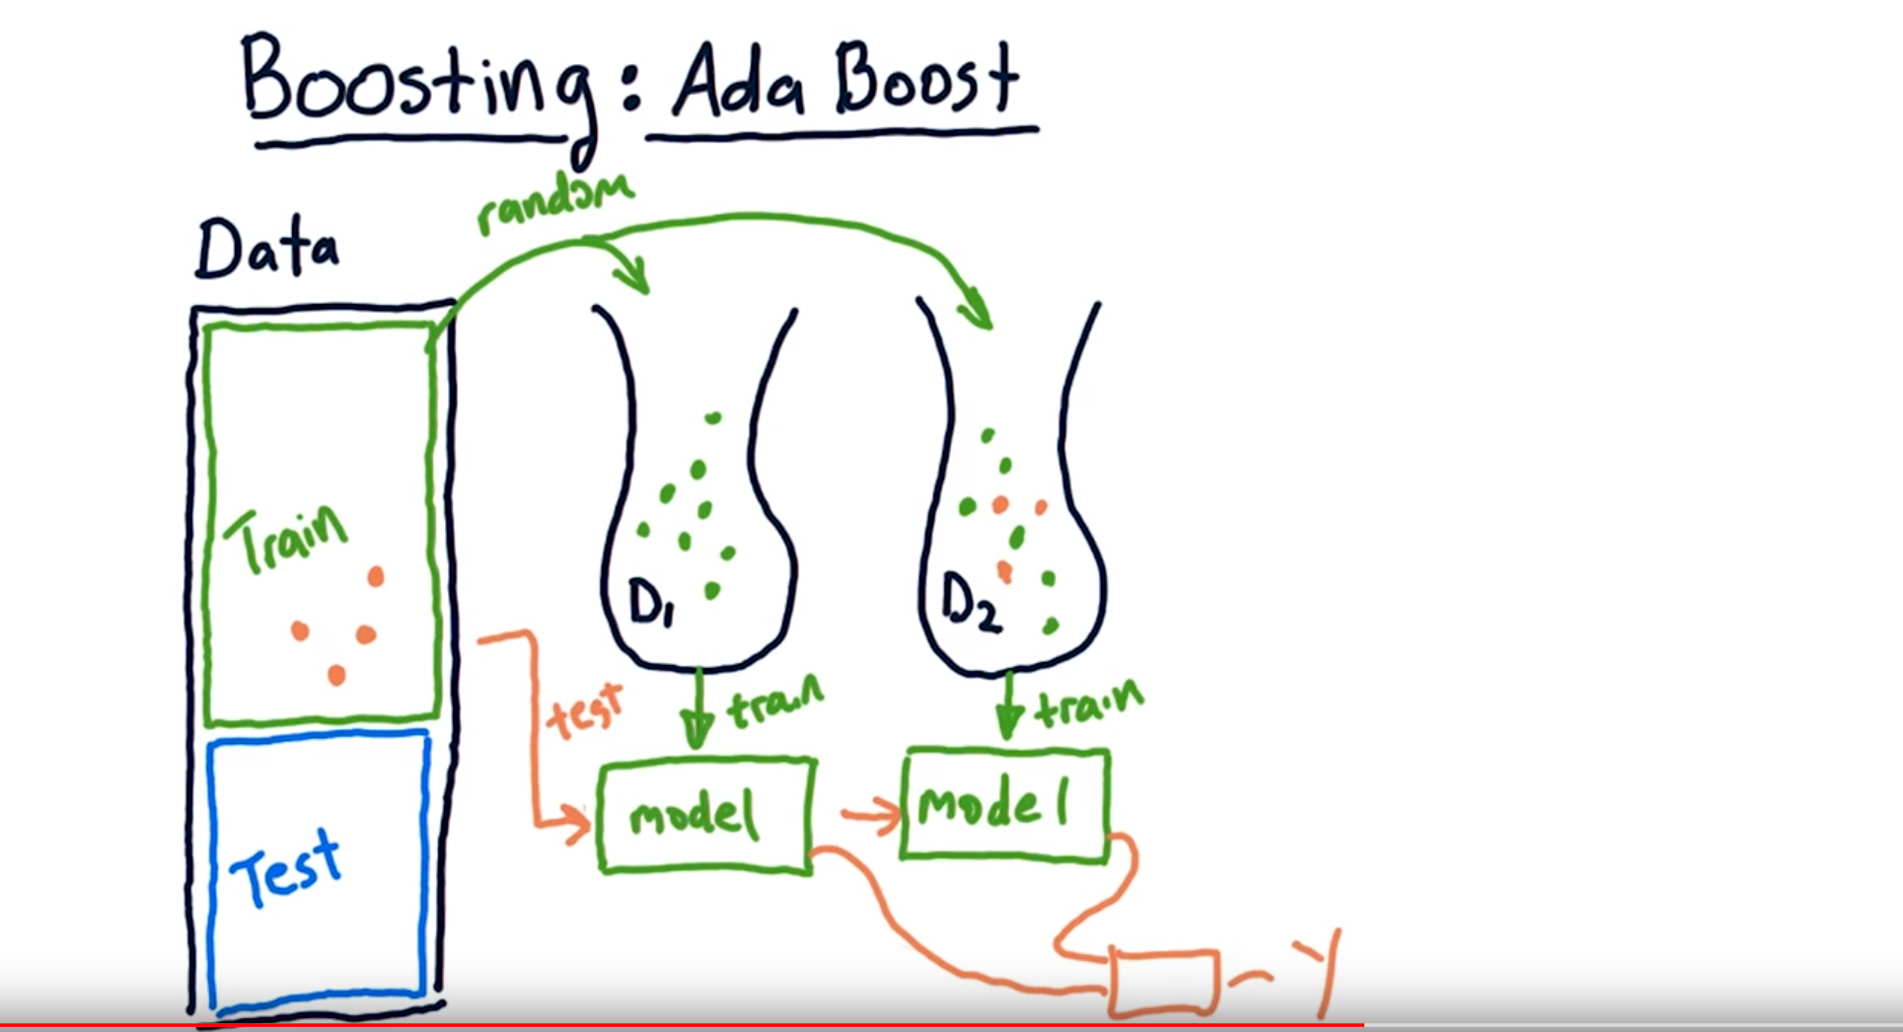
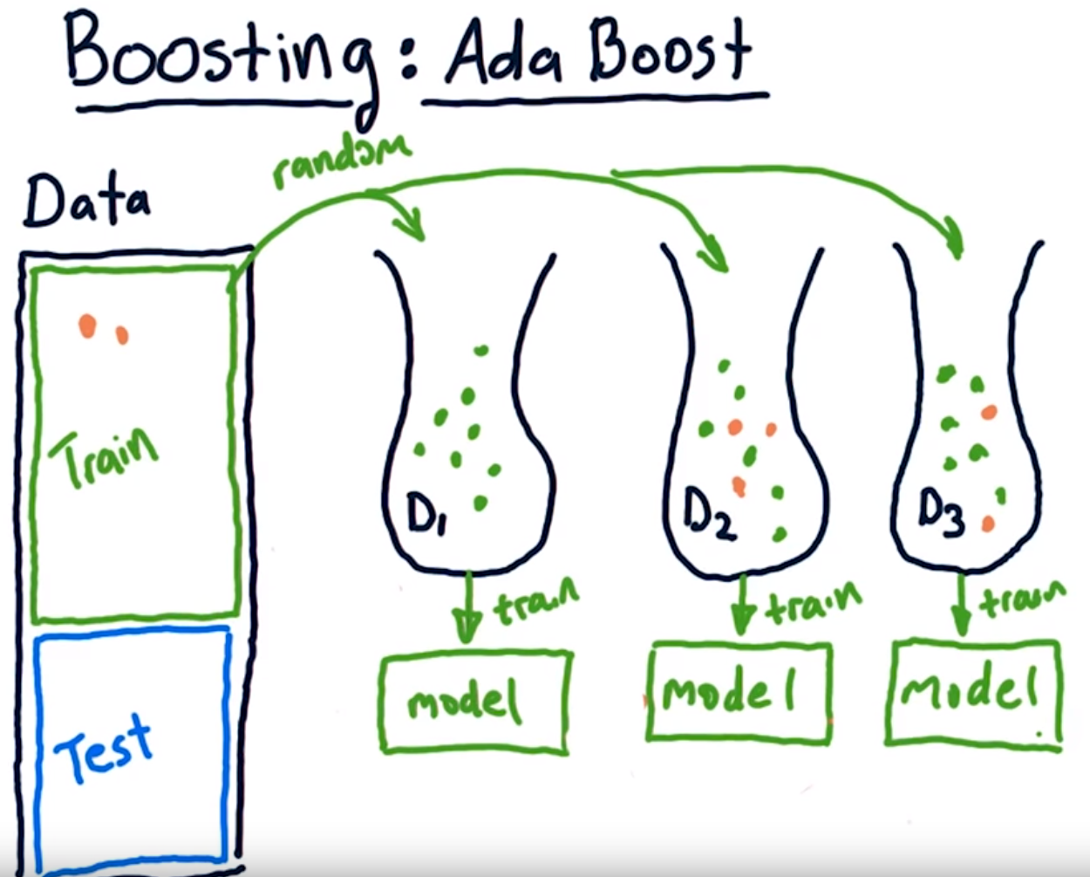
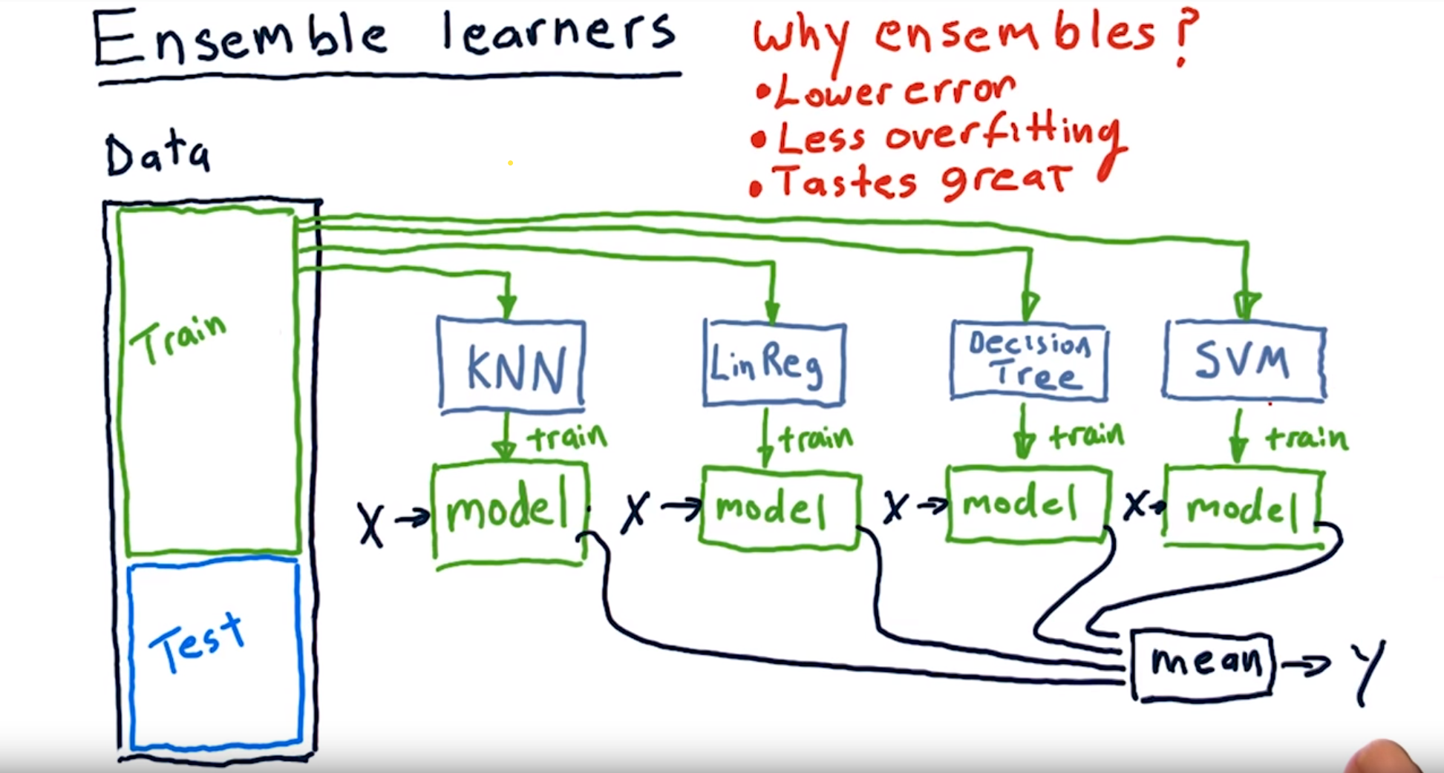
Bootstrap/Boosting

Slide 13
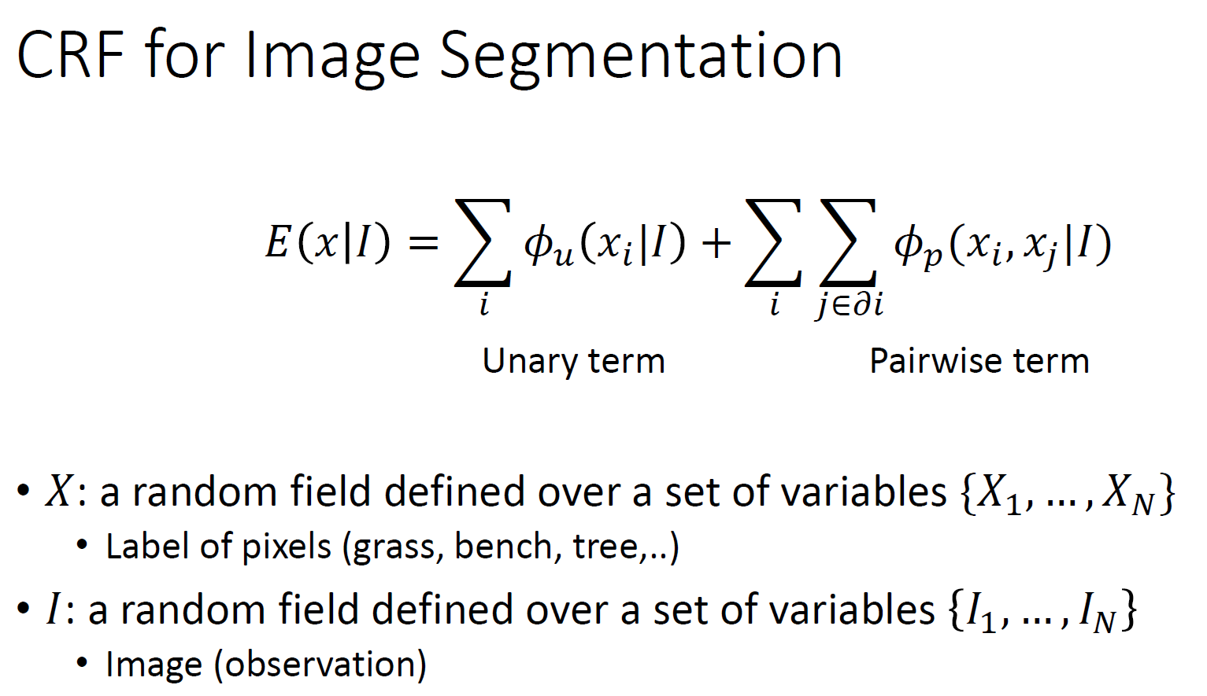
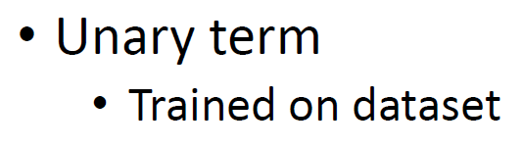
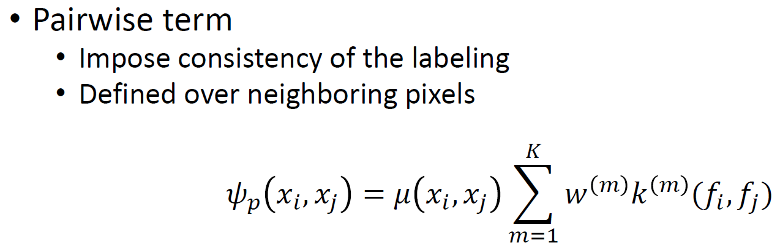
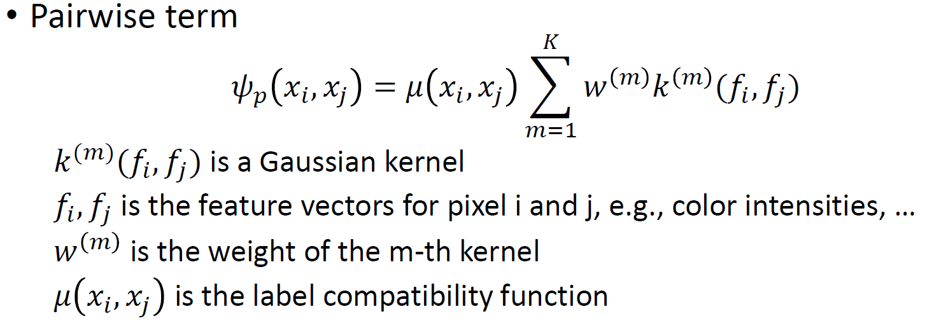
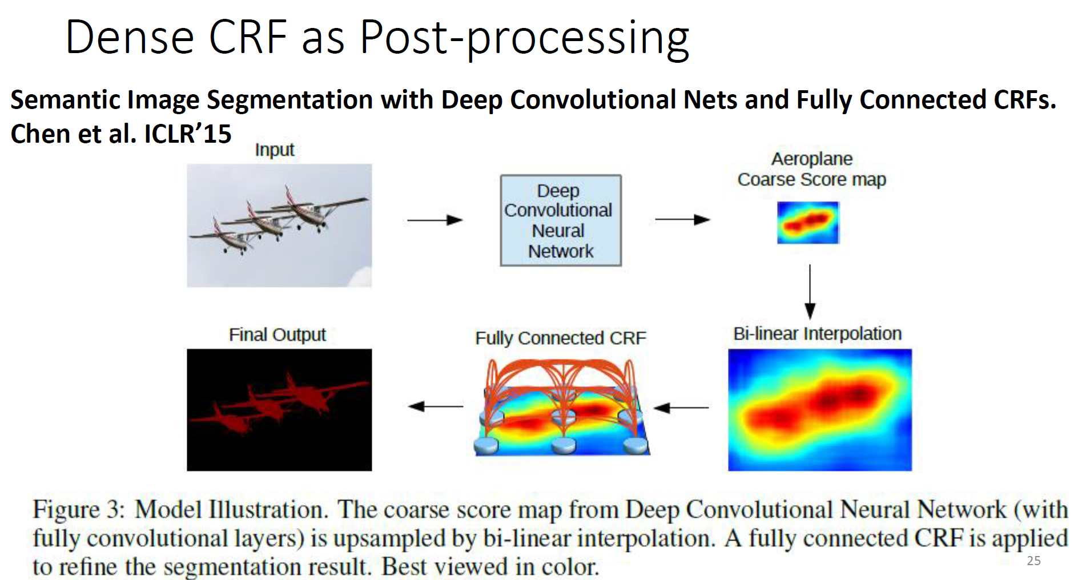
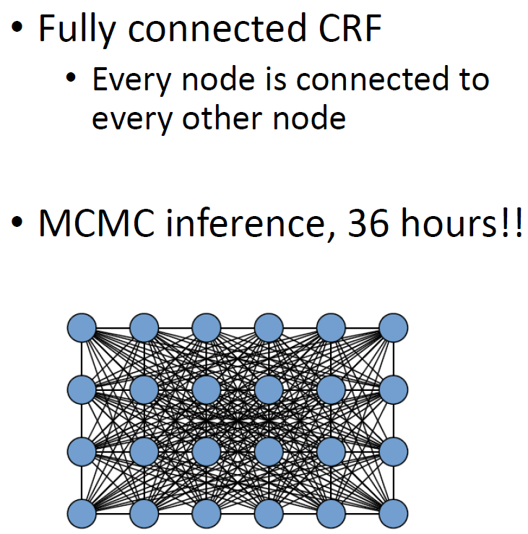
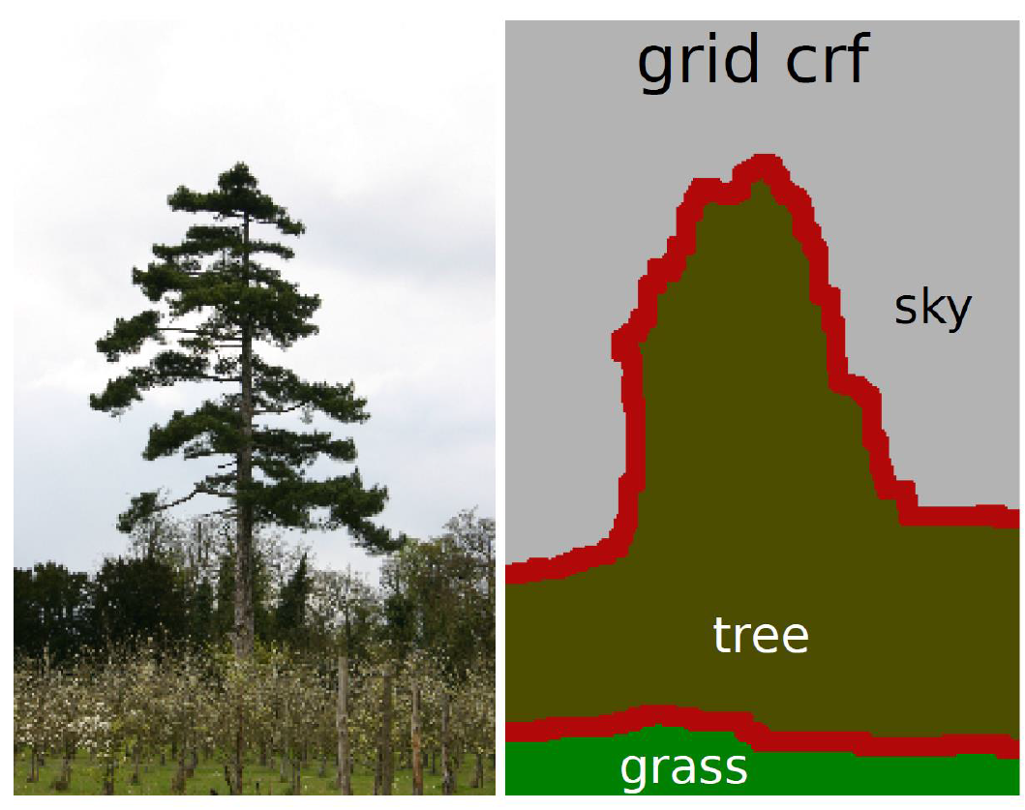
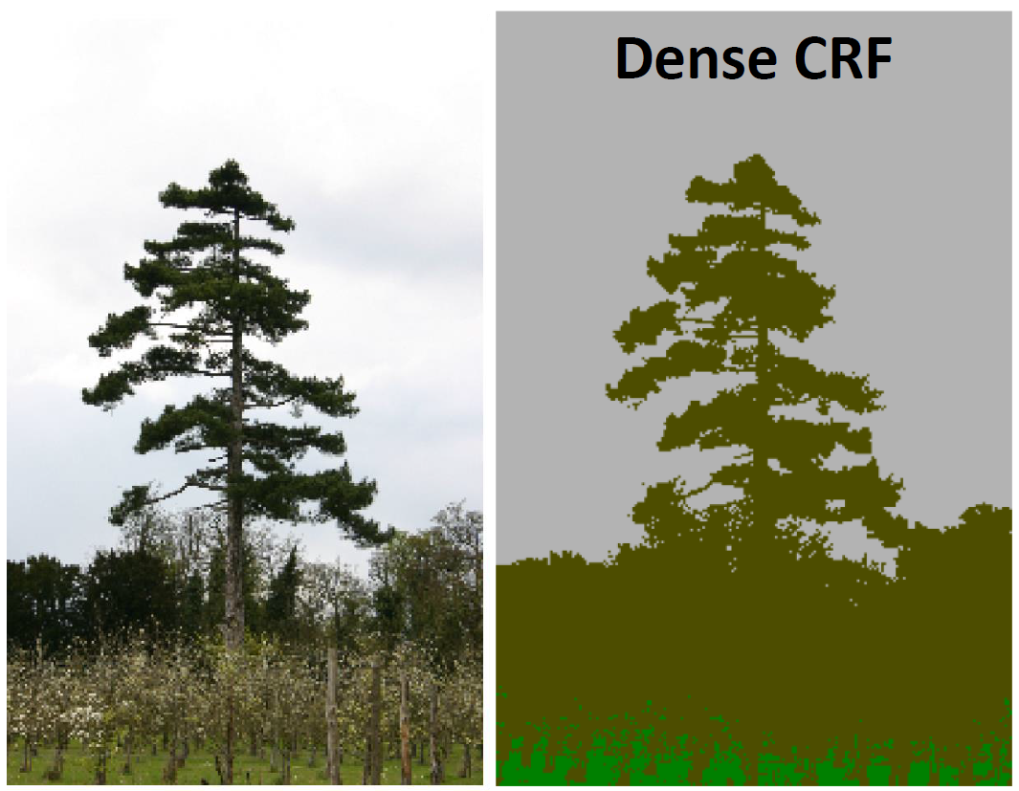

Slide 14
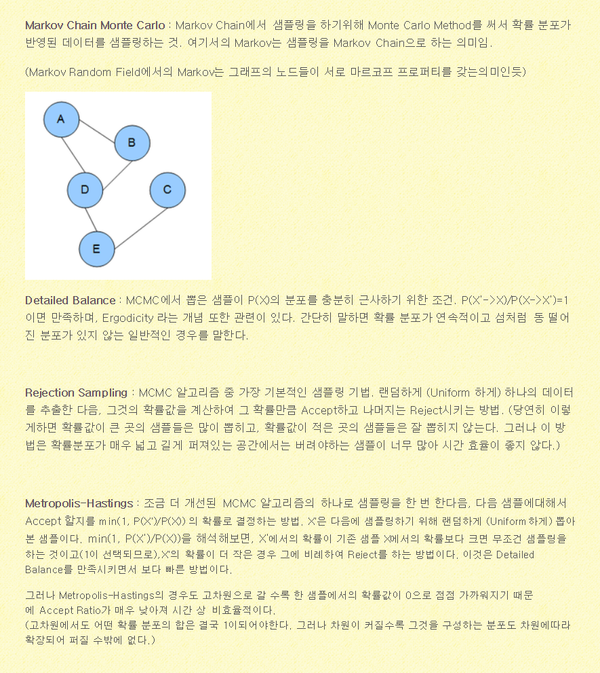
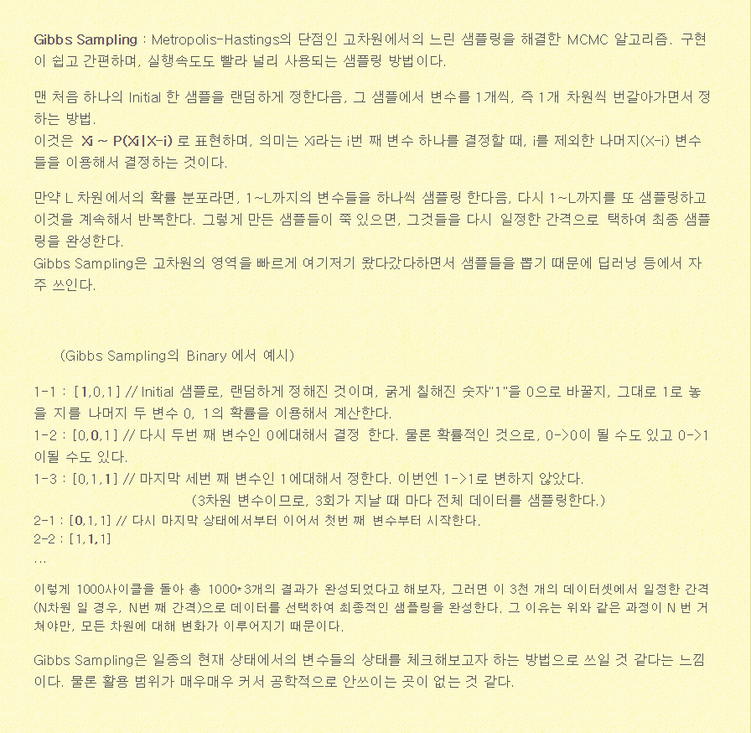
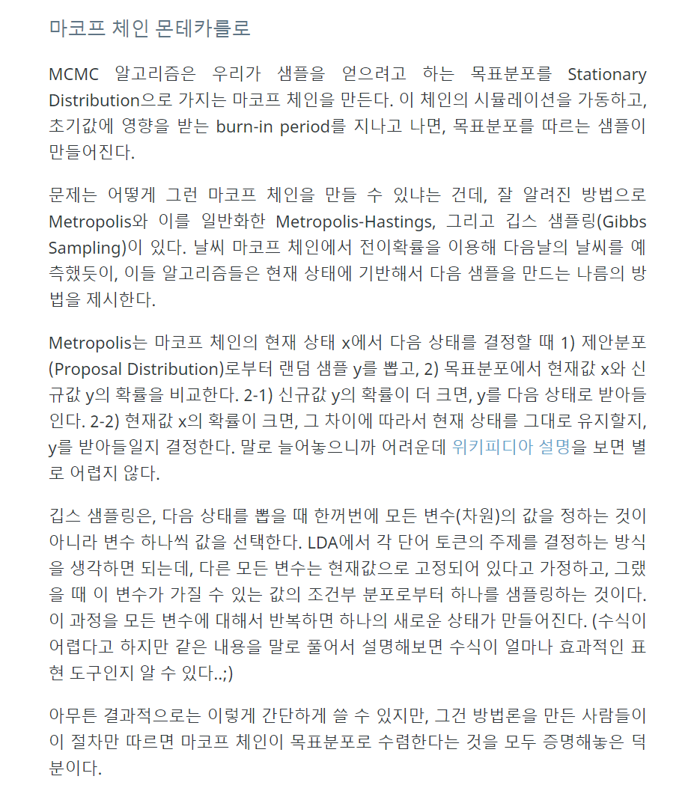
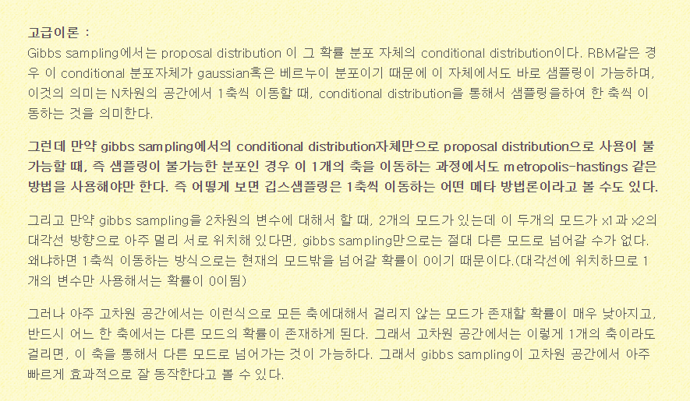
MCMC
직관적인 이해는 부족 향후 업뎃예정
http://newsight.tistory.com/102
http://www.4four.us/article/2014/11/markov-chain-monte-carlo

Slide 15
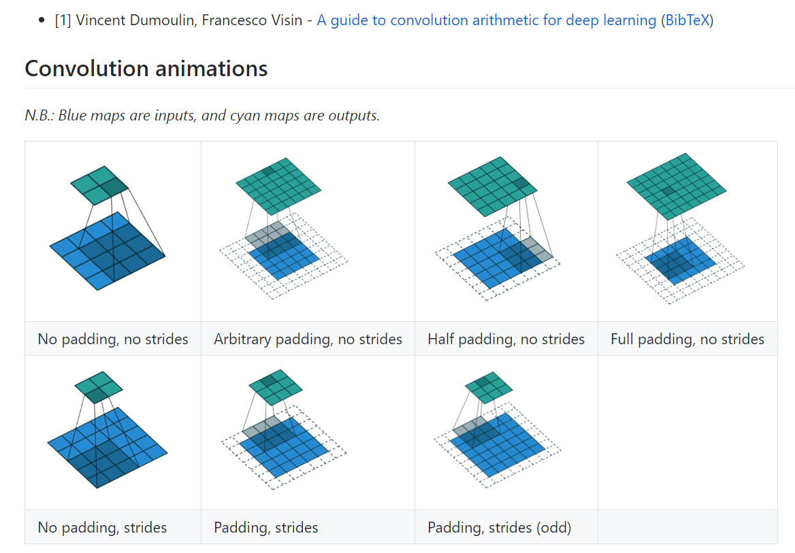


Convolution arithmetic
Zero padding은 왜 할까? Convolution 전/후 image의 크기를 유지하기 위함일까? Image의 경계면의 정보까지 살리기 위함이라는 것도 유념하자

Slide 16


Back propagation
http://home.agh.edu.pl/~vlsi/AI/backp_t_en/backprop.html

Slide 17

Linear Classifier

Slide 18


합성 신경망 Convolutional Neural Network (CNN)
Convolution layer + Pooling == creating feature maps == feature extraction?
Fully connected network == classification?

Slide 19

CNN – LeNet-5 (1998)

Slide 20




CNN – AlexNet(supervision) 2012
AlexNet significantly outperformed all the prior competitors and won the challenge by reducing the top-5 error from 26% to 15.3%.

Slide 21



CNN – ZFNet (2013)
It achieved a top-5 error rate of 14.8% which is now already half of the prior mentioned non-neural error rate. It was mostly an achievement by tweaking the hyper-parameters of AlexNet while maintaining the same structure with additional Deep Learning elements as discussed earlier in this essay.

Slide 22


GoogLeNet (2014)
The winner of the ILSVRC 2014 competition was GoogleNet(a.k.a. Inception V1) from Google. It achieved a top-5 error rate of 6.67%! This was very close to human level performance which the organisers of the challenge were now forced to evaluate.
The network used a CNN inspired by LeNet but implemented a novel element which is dubbed an inception module.
It used batch normalization, image distortions and RMSprop. This module is based on several very small convolutions in order to drastically reduce the number of parameters.
Their architecture consisted of a 22 layer deep CNN but reduced the number of parameters from 60 million (AlexNet) to 4 million.

Slide 23


VGGNet (2014)
VGGNet consists of 16 convolutional layers and is very appealing because of its very uniform architecture. Similar to AlexNet, only 3x3 convolutions, but lots of filters.
The weight configuration of the VGGNet is publicly available and has been used in many other applications and challenges as a baseline feature extractor. However, VGGNet consists of 138 million parameters, which can be a bit challenging to handle.

Slide 24

ResNet (2015)
at the ILSVRC 2015, the so-called Residual Neural Network (ResNet) by Kaiming He et al introduced a novel architecture with “skip connections” and features heavy batch normalization.
Such skip connections are also known as gated units or gated recurrent units and have a strong similarity to recent successful elements applied in RNNs.
Thanks to this technique they were able to train a NN with 152 layers while still having lower complexity than VGGNet. It achieves a top-5 error rate of 3.57% which beats human-level performance on this dataset.

Slide 25
순환 신경망 Recurrent Neural Network
업뎃예정

Slide 26
Unsupervised Learning
업뎃예정

Slide 27





Reinforcement Learning
업뎃예정

Slide 28
Semantic segmentation
업뎃예정

Slide 29
GAN
업뎃예정

Slide 30
참고문헌
http://cs231n.stanford.edu/
http://emergent-enterprise.com/2016/10/why-deep-learning-is-suddenly-changing-your-life-part-ii/
https://beamandrew.github.io/deeplearning/2017/02/23/deep_learning_101_part1.html
https://www.slideshare.net/xavigiro/deep-learning-for-computer-vision-14-image-analytics-lasalle-2016
Andrew Ng, Coursera
https://medium.com/@siddharthdas_32104/cnns-architectures-lenet-alexnet-vgg-googlenet-resnet-and-more-666091488df5
https://laonple.blog.me

Slide 31


ImageNet 이란?

